Slide 1
IMAGE CAPTIONING WITH VISUAL ATTENTION MODELS
LAKSHMI SRIDEVI
EKTA KAPOOR

Slide 2
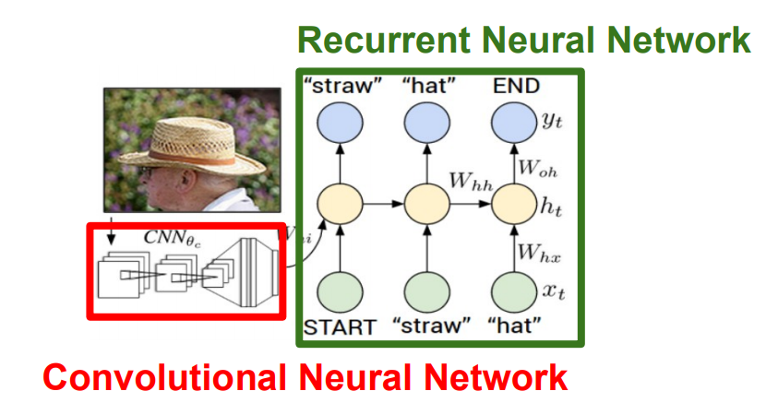
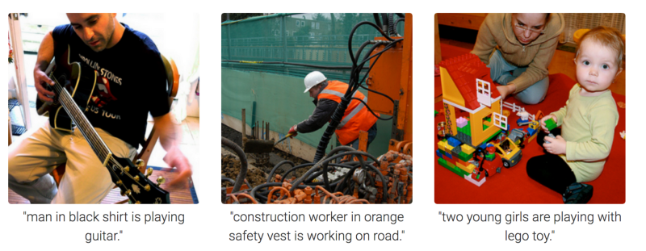
IMAGE CAPTIONING
Image Captioning is the process of generating textual description of an image. It uses both Computer Vision and Natural Language Processing to generate the captions.
Fig 1: Image Captioning Outputs
Fig 2: Framework
https://towardsdatascience.com/image-captioning-in-deep-learning-9cd23fb4d8d2

Slide 3
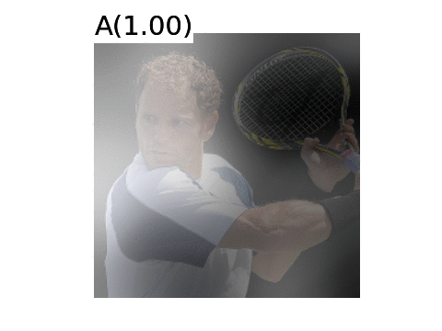
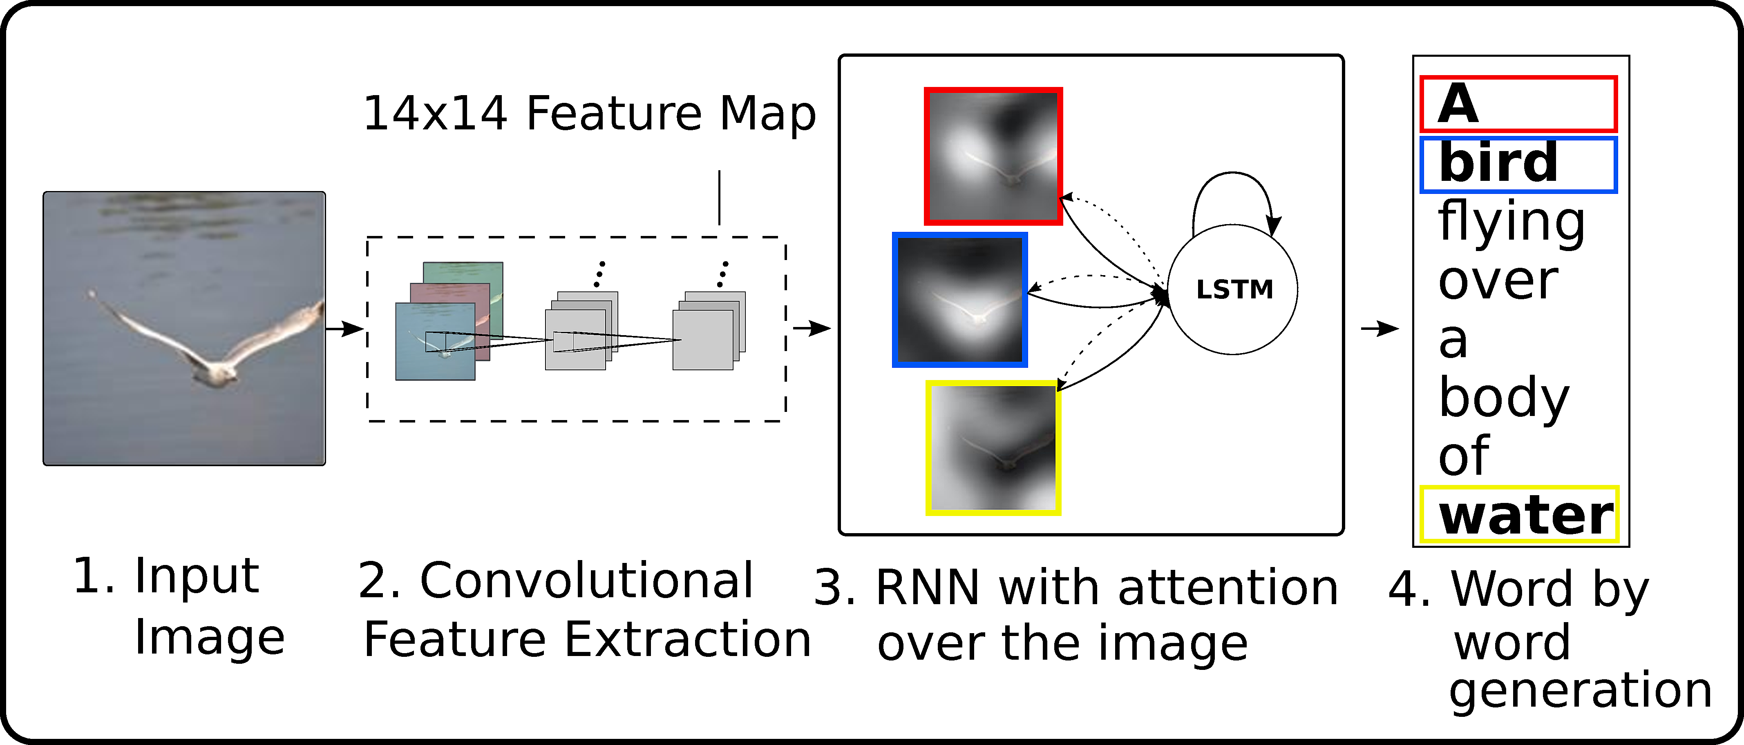
MOTIVATION: NEED FOR ATTENTION MODELS
Attention based model mimics how human vision fixates when you perceive the visual world, the model learns to "attend" to selective regions while generating a description.
This model is incorporated into encoder-decoder framework of the image captioning task to translate the image into its descriptions.
Fig 3: Caption Model with Attention
Fig 4: Attention Map
http://kelvinxu.github.io/projects/capgen.html

Slide 4
OBJECTIVE
Implement Image Captioning without attention on Flickr 8k Dataset. (Vinyals, Oriol, et al. "Show and tell: A neural image caption generator." Proceedings of the IEEE conference on computer vision and pattern recognition. 2015.)
Implement Image Captioning with attention on MS COCO Dataset. (Xu, Kelvin, et al. "Show, attend and tell: Neural image caption generation with visual attention." International conference on machine learning.2015.)
FUTURE GOAL: Implement Image Captioning on Medical Dataset for automatic generation of radiology reports. (Jing, Baoyu, Pengtao Xie, and Eric Xing. "On the automatic generation of medical imaging reports." arXiv preprint arXiv:1711.08195.2017)

Slide 5
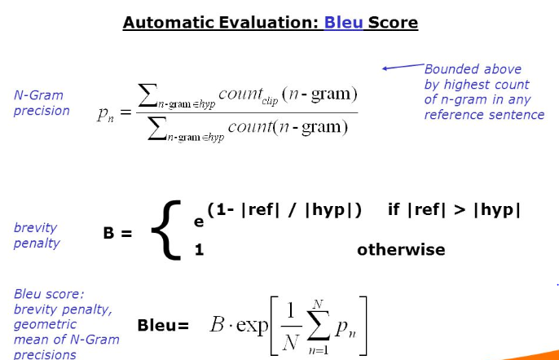
EVALUATION METRIC: BLEU SCORE
A set of high-quality human translations are obtained for a given piece of text, and the machine’s image descriptions/captions are compared against these human baselines, section by section at an n-gram level.
Typically an output score of ‘1’ matches perfectly with the human translations, and a ‘0’ means that the output sentence is completely unrelated to the ground truth.
The most representative within Machine Translation and Image Captioning include: BLEU 1-4 (n-gram with n=1-4)
Fig 5: BLEU Score Calculation
http://kv-emptypages.blogspot.com/2017/04/the-problem-with-bleu-and-neural.html

Slide 6
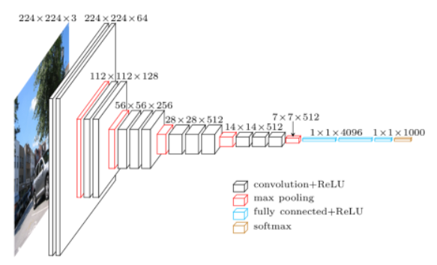
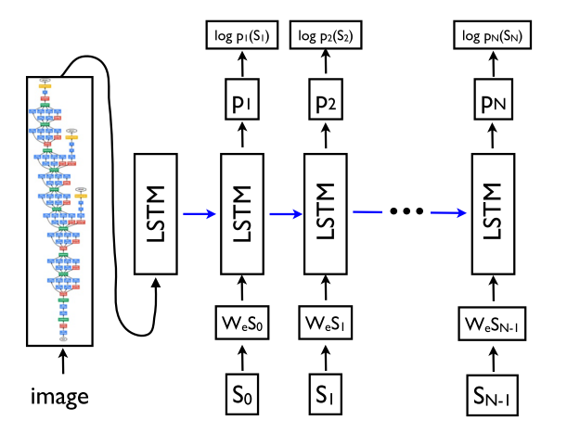
IMPLEMENTATION DETAILS
1. Image Captioning without Attention
Dataset: Flickr8k: 6000 training images, 1000 validation images, 1000 test images
CNN Encoder: VGG16 Pretrained on ImageNet
RNN Decoder: LSTM
BLEU Score: BLEU 1: 0.46 (State of the art: 0.57)
BLEU 2: 0.24 (State of the art: 0.39)
BLEU 3: 0.17 (State of the art: 0.26)
BLEU 4: 0.09 (State of the art: 0.17)
Fig 6: Architecture
(Vinyals, Oriol, et al. "Show and tell: A neural image caption generator." Proceedings of the IEEE conference on computer vision and pattern recognition. 2015.)

Slide 7
Photo Feature Extractor. This is a 16-layer VGG model pre-trained on the ImageNet dataset. We have pre-processed the photos with the VGG model (without the output layer) and will use the extracted features predicted by this model as input.
Sequence Processor. This is a word embedding layer for handling the text input, followed by a Long Short-Term Memory (LSTM) [256] recurrent neural network layer
Decoder: Both the feature extractor and sequence processor output a fixed-length vector. These are merged together and processed by a Dense layer to make a final prediction.

Slide 8
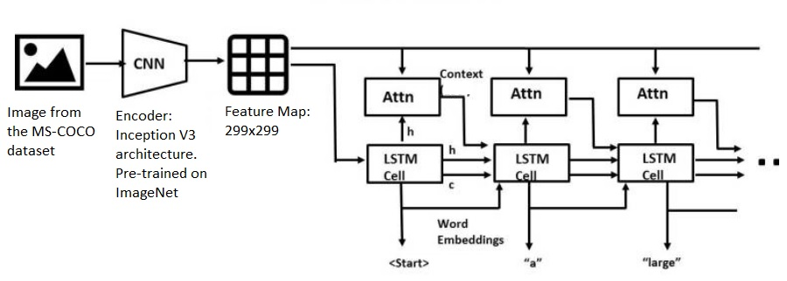
IMPLEMENTATION DETAILS
2. Image Captioning with Attention
Dataset: MS COCO (2014 version) : 82,783 training images, 40,504 validation images, 40,775 test images
Subset of Data used: 30,000 image caption pairs (ease computation)
CNN Encoder: Inception v3. Pretrained on ImageNet
RNN Decoder: GRU
BLEU Score: BLEU 1: 0.52 (State of the art: 0.707)
BLEU 2: 0.32 (State of the art: 0.492)
BLEU 3: 0.18 (State of the art: 0.344)
BLEU 4: 0.14 (State of the art: 0.243)
Fig 7: Architecture
Xu, Kelvin, et al. "Show, attend and tell: Neural image caption generation with visual attention." International conference on machine learning.2015

Slide 9
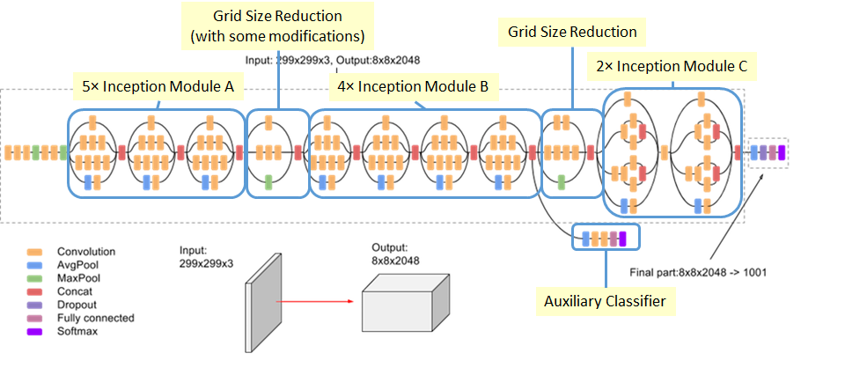
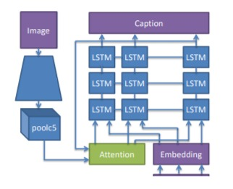
Fig 8 : Inception v3 encoder
Fig 9 : Decoder with attention
TRAINING
The features from the image are extracted using the Inception v3 encoder by removing the FC layer.
The encoder output, hidden state and the decoder output (start token) is passed to the decoder.
The decoder hidden state along with the context vector(from attention model) are used to calculate the loss.
Teacher-forcing is used to decide next input to the decoder.
The gradients are calculated and applied to the optimizer and backpropagated.
http://cs231n.stanford.edu/reports/2016/pdfs/362_Report.pdf

Slide 10
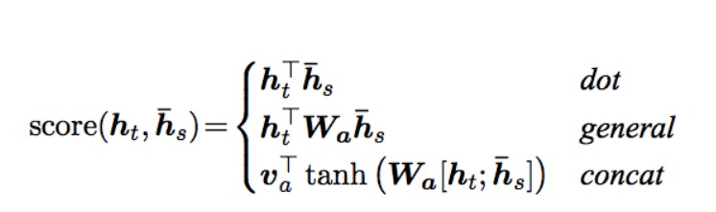
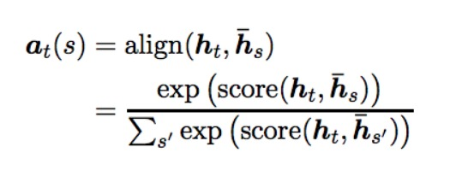
Fig 10 : Attention Equations
TESTING:
The input to the decoder at each time step is its previous predicted word along with the hidden state and the current context vector.(obtained from the attention model)
Prediction is stopped when end token is encountered.
Attention maps are plotted and BLEU score is calculated.

Slide 11
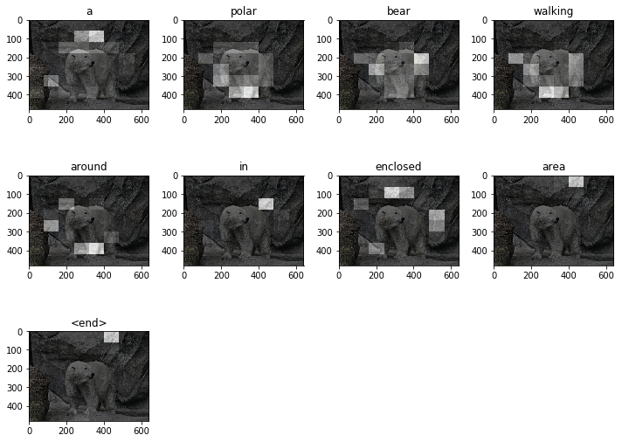
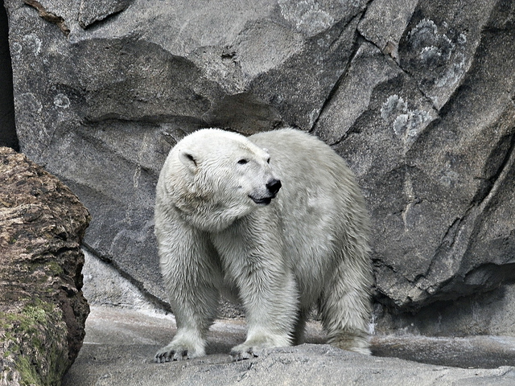
CORRECT CAPTION OUTPUT AND ATTENTION MAP
Fig 11: Test Image
Reference Caption: A dirty polar bear standing on a rock
Predicted Caption: A polar bear walking around in enclosed area
Fig 12: Attention map

Slide 12
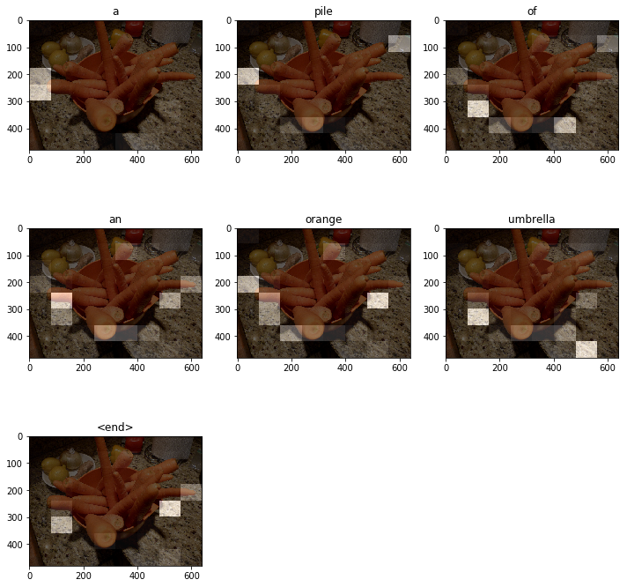
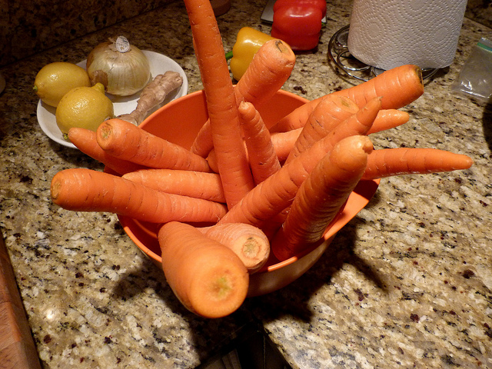
INCORRECT CAPTION OUTPUT AND ATTENTION MAP
Fig 13: Test Image
Reference Caption: carrots in a bowl with onions lemons garlic and peppers behind them
Predicted Caption: a pile of an orange umbrella
Fig 14: Attention map

Slide 13
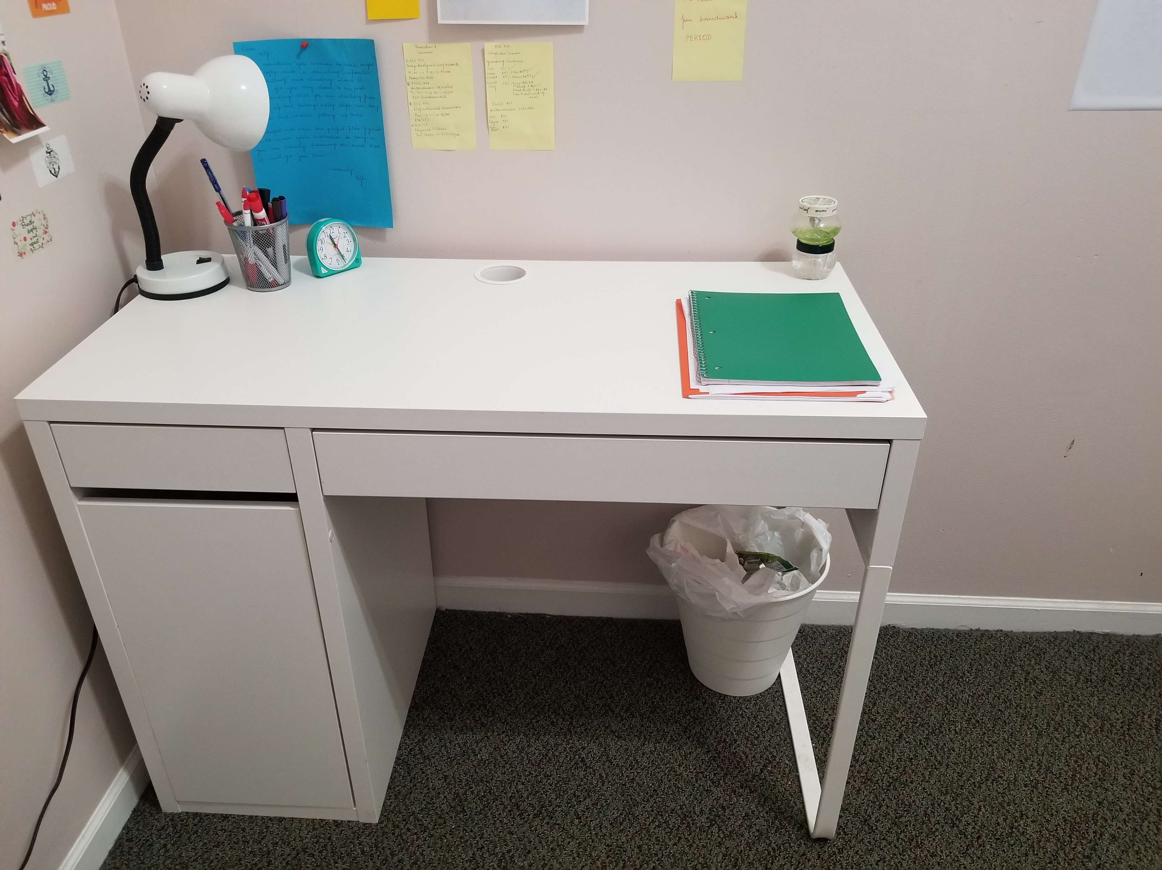
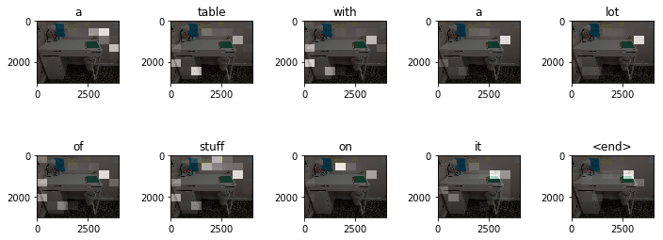
OUR IMAGES : ATTENTION MAPS
Wow I can’t believe that worked
Predicted Caption: a table with a lot of stuff on it
Fig 15: Test Image
Fig 16: Attention map

Slide 14
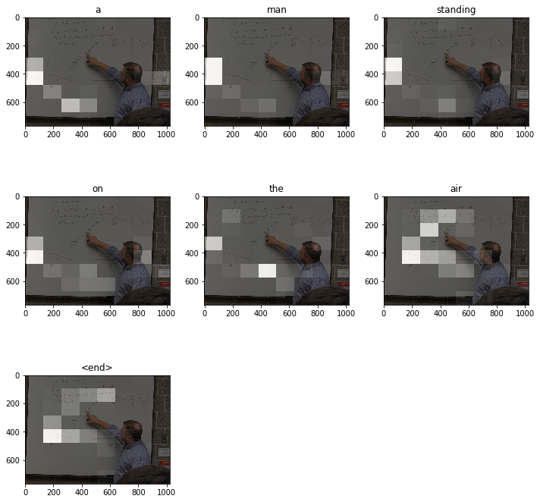
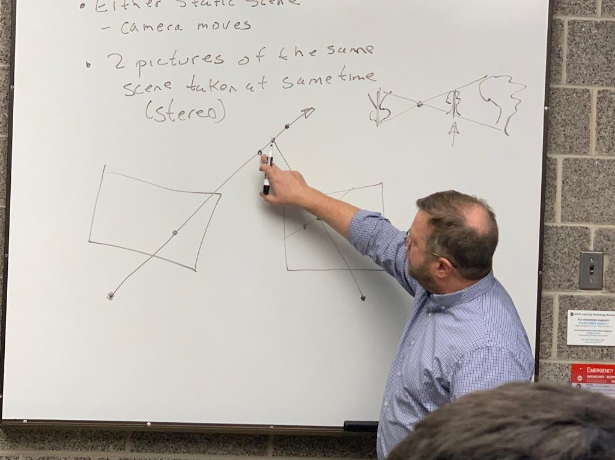
OUR IMAGES: ATTENTION MAPS
Well, I can kind of see it
Fig 17: Test Image
Predicted Caption: a man standing on the air
Fig 18: Attention map

Slide 15
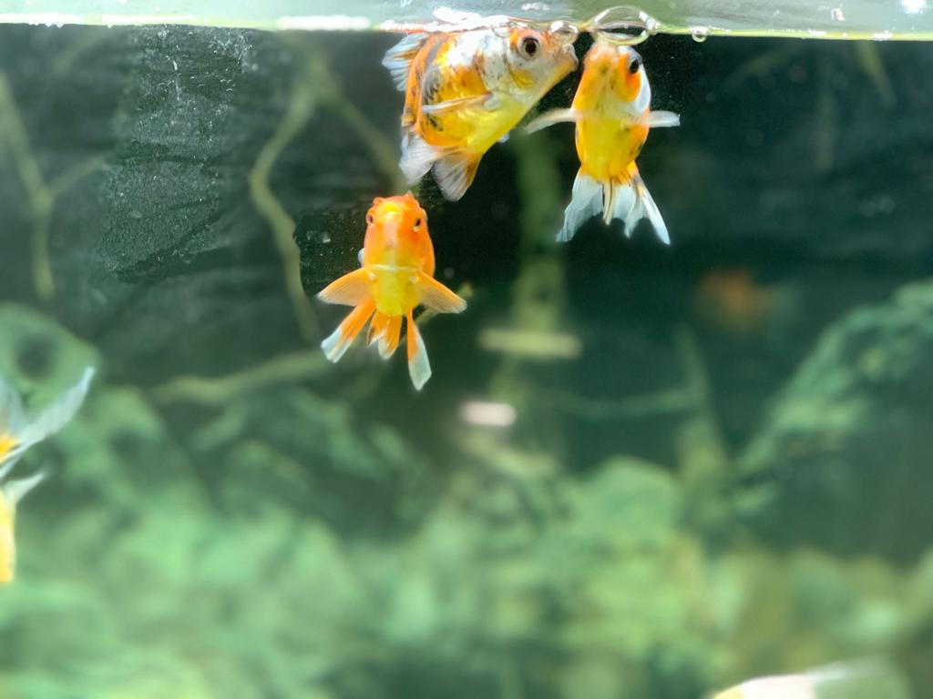
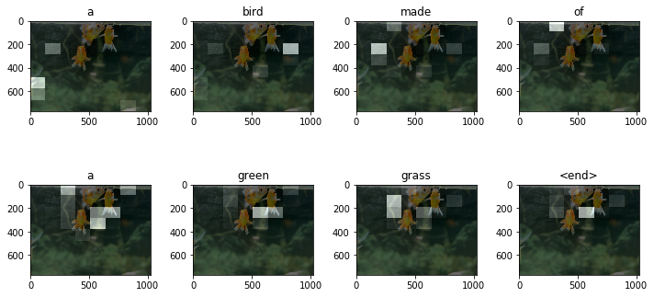
OUR IMAGES ATTENTION MAPS
Not sure what happened there.
Predicted Caption: a bird made of a green grass
Fig 19: Test Image
Fig 20: Attention map

Slide 16
OUR JOURNEY/CONTRIBUTIONS/CHALLENGES LOG
Implementation of Image Captioning without Attention: FLICKR 8K dataset
Challenges: Overall BLEU Score not up to the mark with current state of the art.
Brainstormed Solution: Use a larger dataset(MS COCO), Use deeper Neural Network (Inception V3), GRU
Implementation of Image Captioning with Attention: FLICKR 8K dataset (Iteration 1)
Challenges: Preprocessing challenge(incorporating data captions into desired format for architecture)
Brainstormed Solution: Use Compatible dataset.(MS COCO)
3. Implementation of Image Captioning with Attention: MS COCO dataset (Iteration 2)
Challenges: Computationally intensive, did not include BLEU metric( Could not implement changes easily.)
Brainstormed Solutions: Use a subset of captions and images. (Trade-off made: Lesser BLEU score), implemented BLEU score for comparison.
4. Implementing Local Attention Model (Predictive alignment) into current architecture.
Challenges: Did not get desired output since attention was used on only few source positions.
5. Implementing Current Architecture for Automatic Captioning of Radiology images: PIER Gross Dataset
Challenges: Cannot use pretrained ImageNet images.

Slide 17
INDIVIDUAL CONTRIBUTION
PROJECT TASKS
Literature Survey & Model Architecture:
ENCODER: VGG 16, VGG 19, Inception V3 (Lakshmi)
DECODER: LSTM, GRU, Word Embedding, Text Preprocessing (Ekta)
2. Implementation of Image Captioning without Attention: FLICKR 8K dataset (Ekta)
3. Implementation of Image Captioning with Attention: FLICKR 8K dataset (Iteration 1) (Ekta)
4. Implementation of Image Captioning with Attention: MS COCO dataset (Iteration 2) (Lakshmi)
5 Incorporating Custom Attention Model into (2): (Lakshmi)
5. Incorporating BLEU Metric into (4): (Ekta)
6. Implementing Global Attention Model (Dot-Product) into current architecture. (Lakshmi)
7. Implementing Current Architecture for Automatic Captioning of Radiology images: (Ekta, Lakshmi)

Slide 18
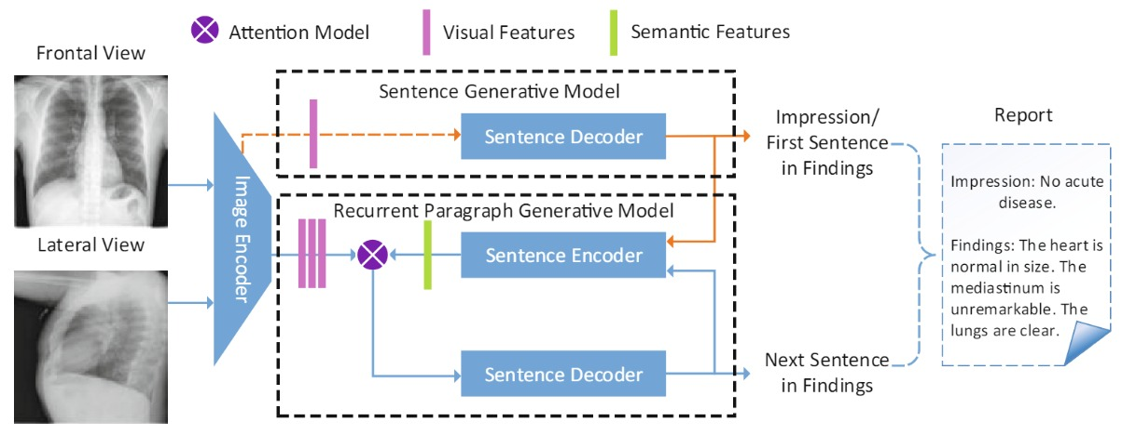
FUTURE SCOPE
Fig 21: Mechanism
The implementation can be extended to generate automated radiology reports with additional functionality such as semantic attention.
We can generate high level conclusive impressions and detailed descriptive findings sentence by sentence to support the conclusion.
Multimodal Recurrent Model with Attention for Automated Radiology Report Generation

